Slide 1
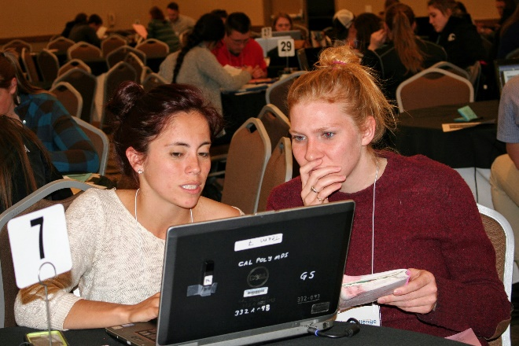
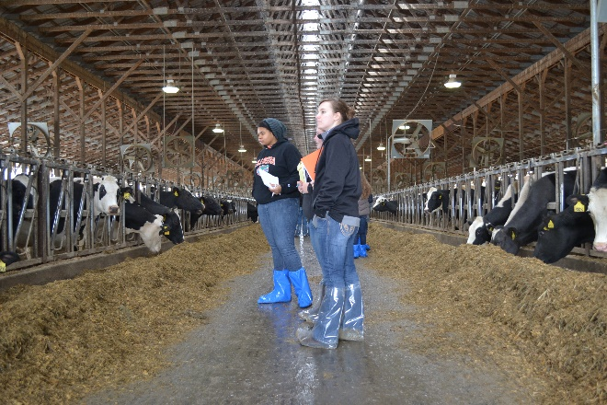
2024 National Dairy Challenge and Academy April 4-6, 2024 Visalia Convention Center and Visalia Marriott in Visalia, California
https://www.dairychallenge.org/contests/

Slide 2
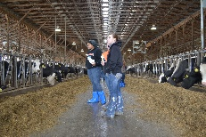
2024 Overview
Have both a Contest for up to 36 teams and an Academy for up to 120 students. Aggregate Contest teams will be formed if we don’t have at least 32 university teams.
As our event is primarily funded by corporate sponsors, please ensure your students understand the privilege and exposure that is being extended to them by participating. They are expected to fully participate in all event activities.
No formal program on Thursday. Official program begins with dinner at 5:30 PM.
Farm visits and presentation preparation on Friday.
Presentation and education day on Saturday.

Slide 3
What’s New for 2024
Thursday:
Events officially begin with dinner on Thursday evening.
Local committee has a list of suggested activities for any early arriving schools
Visit area farms
We will provide a list of participating dairies and schedule for those interested.
California State Holstein Show and Spring Jersey Show is April 4-5 in nearby Tulare
Heifers show on Thursday
NAIDC will pay for rooms Thursday-Saturday nights and meals beginning with Thursday evening - Saturday awards dinner. Wednesday night hotels and breakfast/lunch on Thursday are the responsibility of the university.
Notes:
TED

Slide 4
What’s New for 2024
Contest:
Friday Manager Interviews will consist of 2 sets of 2 teams from different judging panels sharing interview times
interview times expanded to 20-minute time blocks (17-minute interviews)
Notes:
TED

Slide 5
What’s New for 2024
Enhanced Academy Experience
Continue with mixed teams
120 total Academy Students - Group size will be 6 with 1 advisor per team
Some level of dairy management preparedness is preferred for student success
There will be several floating advisors in both rooms. Floaters will have areas of expertise and will continually move from table to table.
Adjusting Saturday schedule to allow groups to present for 20 minutes (similar to the contest experience)
We encourage coaches to be floating advisors
IT support will be in both rooms for software questions
Advisors will be instructed to have questions for students during Saturday presentations
Notes:
TED

Slide 6
What’s Continuing for 2024
Contest and Academy Participants should plan to use their own computers for the contest.
It is important that each school team has at least 2 computers.
Mac’s do not work with the dairy software, so schools may need to make arrangements for students who have Macs.
All participants should review computer and software requirements.
Dairy software (PCDART and Dairy Comp) is available for downloading from the NAIDC website. Students should download the software to their computers BEFORE coming to Visalia. Support is available if needed.
In addition to students bringing their own computers, we ask each school bring at least one school computer, two if available, to serve as back up should one of your students experience computer failure.

Slide 7
What’s Continuing for 2024
Students should prepare a resume for upload to the national web site.
If they uploaded one for a regional, they will have the option to either upload again or authorize us to use the one previously submitted.
The upload link will be available on the national contest page.
Resumes will be distributed to sponsors for recruiting purposes. In addition, students should bring copies with them for the Career Fair on Saturday.

Slide 8
What’s Continuing for 2024
Farm Data will be Online
Most Contest and Academy materials will be posted to a secure web site only accessible by registered participants. Students will get early access to the questionnaire the week of the contest; the rest of the contest data will be released once onsite. We are asking coaches to ensure that all contest data is removed from your students’ computers after the contest ends.
Presentation Turn In will be via Upload
Students will receive instructions onsite for uploading their presentation saved in PowerPoint.

Slide 9
What’s Continuing for 2024
Travel Policy
As noted in your invitation letter, a pool of sponsor funds has been set aside to support national contest travel costs for schools in need. The stipend amount will depend on the number of applications approved. Schools must have a team competing in the national contest and must travel (drive or fly) at least 800 miles to be considered for the stipend. Deadline to submit this form: February 1, 2024.

Slide 10
Internet
Students may use the internet as a resource in their presentation preparation.
The purpose of allowing student computers and internet access is to provide a more real-world experience with access to additional resources to help address specific questions that arise during the farm analysis.
In addition, there are no restrictions on the use of pre-planned repositories for contest resources or on what dairy management resources are brought to the contest for use in preparing presentations.

Slide 11
Other tools
Cameras: Contest teams should bring a camera for use on the farm. Use of cell phone, IPad, or other similar cameras is prohibited at the farms.
Schools should bring a calculator, measuring tape, watch/stopwatch, pens and clean notepads.
Contest students are NOT to wear clothing with identification of their respective school any time during the event.

Slide 12
Printed Data
Farm Map
Contest and Academy Schedules
All other contest material will be electronic
Participants will receive an email with information for accessing the contest data site

Slide 13
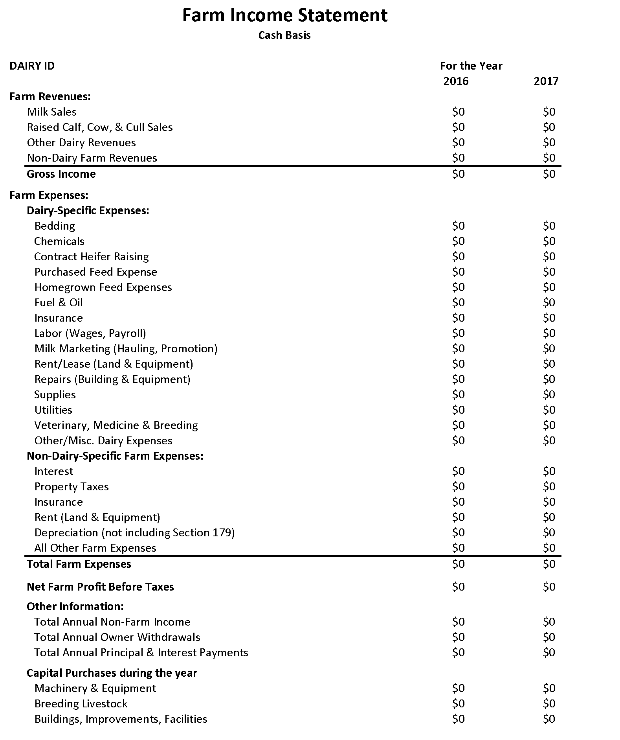
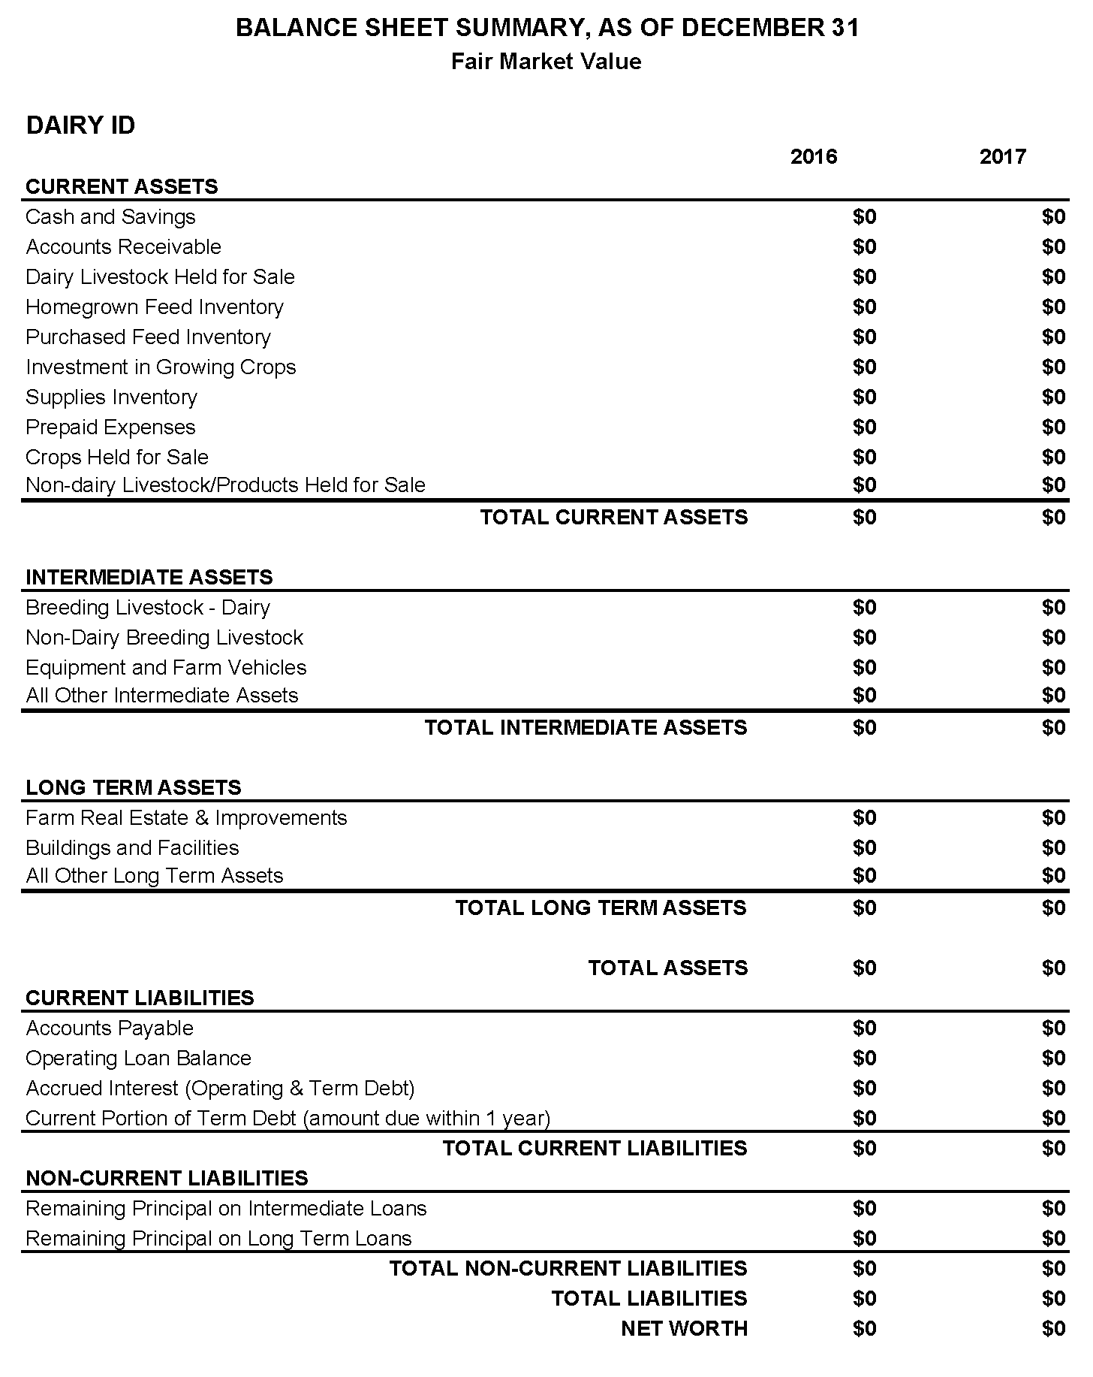
Financial Information Template

Slide 14
Financial Information Template
Financial template posted on the resources site: https://www.dairychallenge.org/pdfs/student_resources/NAIDC_Financials_Template.pdf
Additional resources available at:
https://www.dairychallenge.org/student-resources/
Closer to the contest we will also post financial benchmarks for California dairies

Slide 15
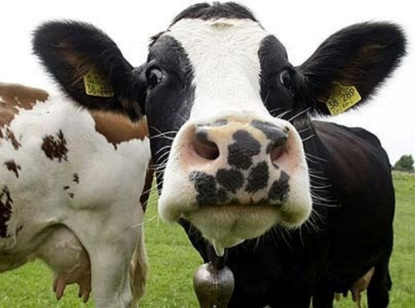
2024 Herds
Herds for 2024 Contest
4 judging panels/2 herds
1 herd 6,000 cows, 5,500 heifers
1 herd 3,600 cows, 2,800 heifers
Herds for 2024 Academy
2 herds/groups split between herds
1 herd 4,400 cows, 4,200 heifers
1 herd 3,900 cows, 2,600 heifers
Notes:
CATHY

Slide 16
2024 Herds
All herds are on DHI test
All herds (contest & Academy) process thru Agri-Tech.
All herds use Dairy Comp 305
Data will be loaded into DC305, DHI-Plus and PC-DART
Health events by month and DIM will be provided as an Excel Spreadsheet
We will be asking students on their form if they have had a job or internship on a California dairy to avoid any conflicts.
Notes:
CATHY

Slide 17
2024 Herds
Diets
Penn State Particle Separator (shaker box) for High Group diet and prefresh/close-up group
Copies of all diets will be provided
Map to match group to ration
Notes:
CATHY

Slide 18
2024 Herds
Milk Marketing Programs in California
(milk over base)
Farms have a base
Reduction in milk price for milk produced over base
Programs are specific to the coop/handler farms ship to
Base amounts and details for each farm to be included in data provided to farms.
Notes:
TED

Slide 19
Contest
Manager Interviews
Un-opposing teams from Dairies AB and CD will interview dairy manager together on Friday afternoon, for example Teams 10 and 19 will interview dairy together.
Interviews will be 17 minutes each – 20-minute blocks
Notes:
TED

Slide 20
Examples of Appropriate and Inappropriate Questions
Invalid: How much overcrowding do you have in pen one?
Allowed: What is your definition of over-stocking?
Invalid: What is your biggest metabolic problem?
Allowed: The number of ketosis cases in your database indicate a big problem; are these data correct?
Invalid: What is your biggest reproductive problem?
Allowed: The data show that your cows average 120 days open; is that a correct value?
Invalid: How much do your cows eat in one day?
Allowed: Do you weigh the feed provided and feed that is refused daily? Or Are the feed intake data in the TMR management software a true reflection of the cow’s consumption?
Notes:
TED

Slide 21
Contest
Presentation format: Can use Google slides for preparation but final presentation must be in PowerPoint.
Reminder that at national, there is no prep room. Morning presenting teams should plan time on Saturday morning to practice, afternoon presenting teams should plan time on Saturday afternoon to practice.
Students will gather in a holding area 15 minutes prior to presentation and will be escorted to the presentation room.
Notes:
MOLLY

Slide 22
Thursday Schedule
Thursday April 4
4:45 PM – 5:15 PM Registration for coaches
5:30 PM Dinner, Welcome
7:00 PM Data distribution
For schools arriving early, there are farms offering visits and a cattle show in nearby Tulare.
Notes:
MOLLY

Slide 23
Coaches Tour of Farms
Students will visit the farms on Friday via buses.
Coaches will carpool to the farms in groups at the same time as students on Friday morning
The coaches meeting and reception will be held on Friday afternoon off site at World Wide Sires
Notes:
We ask there be no “contest-related” student/coach interaction during the drive to and from the farm on Friday – no more coaching after Thur night. Also no interaction on the farm.

Slide 24
Friday Evening Event
Sponsor student dinner and mixer offsite at Fernandes’ farm
Excellent networking opportunity for your students to meet and mingle with industry representatives
Student attendance is not optional
Coaches are asked to drive students
Notes:
MOLLY/CATHY

Slide 25
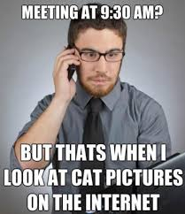
Saturday-when students are NOT presenting
Required to attend the Career and Innovation Fair
Required to attend the Corporate Technology Presentations
Students will need their cell phone on Saturday during debriefing to complete our surveys.
We are asking for your help to ensure all students are onsite all day Saturday

Slide 26
Student Preparation
A variety of items have been posted on the Dairy Challenge web site to aid in student preparation: https://www.dairychallenge.org/student-resources/
Coaches have access to past presentations and data sets that you can also use for student preparation via the “Coaches Resource” link on “Student Resources” page. Login is “coach”
Notes:
Hop over and show them the resource page

Slide 27
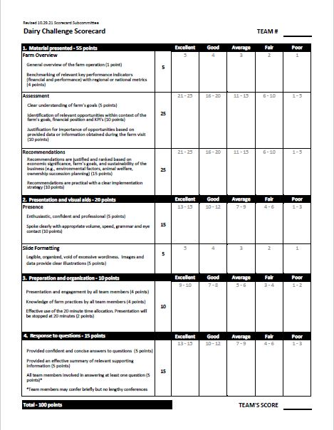
NAIDC Scorecard
The scorecard serves as the basis for evaluating the student presentations.
The scorecard is available on the NAIDC website.
Judges will be reminded to prioritize a team’s ability to defend their recommendations rather than directly align with the judges’ recommendations.
Notes:
MOLLY - this is the basis of evaluation

Slide 28
Housing, Meals and Transportation
Headquarter hotel is the Visalia Marriott which is connected to the Visalia Convention Center
Coaches will receive a housing form with their team confirmation (after Feb 21) to complete and submit to the hotel by Tuesday March 1.
Coaches are responsible for making their school's housing reservations using the NAIDC Housing Form. The Visalia Marriott will house both students and coaches.
Contest and Academy students can room together.

Slide 29
Housing, Meals and Transportation
NAIDC will pay for student rooms that fall within the allotment. Coaches will receive a NAIDC Student Room Allotments table for number of student rooms being paid for by NAIDC.
Coaches are responsible for their own room charges at the national contest. As such, a coach may wish to share a room with a coach from another school. To do so, we suggest one coach make the reservation and other indicate as such on their form. Coaches should not room with students.
Rate per room per night: $164 + tax
Reservation Cut-Off Date is Friday March 1, 2024

Slide 30
Housing, Meals and Transportation
Most meals (dinner Thursday; breakfast and lunch Friday; and breakfast, lunch and dinner Saturday) will be at the convention center. Friday dinner will be offsite.
Schools are responsible for their own transportation arrangements for Thursday activities prior to the start of the contest. Schools are also asked to provide transportation to Friday night’s dinner in nearby Tulare.

Slide 31
Suggested Dress
Thursday evening - Business casual for dinner and data release
Friday morning - Dress in layers for farm tours
Friday Evening - Business casual for dinner with sponsors and fun event (blue jeans are acceptable, but no holes)
Saturday - Professional business for presentation and for the banquet
Dairy Challenge will supply safety vests and plastic boots for the Friday farm visits. Clean personal boots can also be worn to the farm.
Schools doing optional Thursday farm visits should plan to supply their own plastic boots for biosecurity purposes.

Slide 32
Dress Code Guidelines
Professional Attire
Business suit in a conservative color (navy, gray, or black are preferred); women may wear suits with either a skirt or pants
For men: dress shirt and tie
For women: blouse that complements the suit; neckline no lower than collarbone; skirt hem should be no more than two inches above the knee
Clothes clean and pressed
Shoes: for men—wing tips or loafers with dark socks; for women—low/medium heels or flats with neutral hose.
Not-so-Professional Attire
Khakis, jeans, or sweats
Shirt tail not tucked in
Stains or wrinkles
Shoes run down at the heels, scuffed, or not polished
White socks
Colored hose or hose with runs or snags in them
Low necklines
Hemlines on skirts more than two inches above the knee; pants above the ankle
Too tight or too loose clothing
Revealing or provocative
Necktie not properly tied

Slide 33
Dress Code Guidelines
Professional -Hair
Clean and styled
Off your face
For men – short hair is preferable; facial hair should be groomed
Not-so-Professional -Hair
Dirty or unkempt
Excessively long bangs
Playing with your hair
Accessories-Professional
Minimal jewelry: small earrings (one pair only), necklaces, pins, etc. (wedding/engagement rings are acceptable)
Good-quality briefcase or portfolio to hold papers
Cell phone is turned off
Accessories-Not-so-Professional
Visible tattoos or piercings
Excessive or large jewelry
Disorganized materials
Cell phone rings during interview
Heavy or excessive scents

Slide 34
Social Media Corps Opportunity
Accepting applications for students interested in serving on this year’s Social Media Corps team
Seeking 4 students
Visit with students in your dairy club and ag communications department about this opportunity
Application is on the Dairy Challenge website

Slide 35
NAIDC Turns 20!
The first Dairy Challenge contest was held in 2002 at Michigan State University.
We will be celebrating our 20th anniversary with some special activities in Green Bay.
Our Challenge: Tera Montgomery
Notes:
Turn over to TERA

Slide 36
Dates to note
January 10 National Contest & Academy invites sent
February 21 forms and fees due
After February 21 confirmation letters will be sent
March 1 student information forms due
WE schools should submit entry forms by Feb 21 but have until March 1 to finalize student names. Additional flexibility offered on March 1 student forms deadline as well.
March 1 Housing forms due to hotel

Slide 37
Communication is Important
Please respond quickly to e-mails from Cassi Miller or Molly Kelley
Please notify Cassi Miller of any changes to your team.
Make certain that your students have filled out the Student Information Form and uploaded their resumes by the deadline

Slide 38
Final details…
We need at least 10 LCD projectors for the event. Let us know if you can bring one.
Schools should bring 1-2 additional computers
If you have any questions, contact
Megan Mauw or Cathy Myers (local host committee) – MEGAN.MOUW@elancoah.com; cathym@amelicor.com
Ted Halbach (program committee chair) – tjhalbach@wisc.edu
Cassi Miller (NAIDC registrations) - cmiller@wdexpo.com
Molly Kelley (NAIDC) – mollyk@dairychallenge.org

Slide 39
We could not do this without you!

